Slide 1
Lesson 3
Course Overview:
Harnessing Nature’s Self-Referral Dynamics For Success
Notes:
ID Course Overview
4/1/04 kl this file has all the slides from the overview lesson through uc analysis. I simplified the overview slides, and removed the main points slides from the first couple lessons (since redundant with syllabus main points—but then left some in, since these are w/o sci points and hence not totally redundant)
“REVIEW OF KEY POINTS” -- Removed a few questions that were not so relevant to the SWEng course. Kl 29 Oct 02

Slide 2
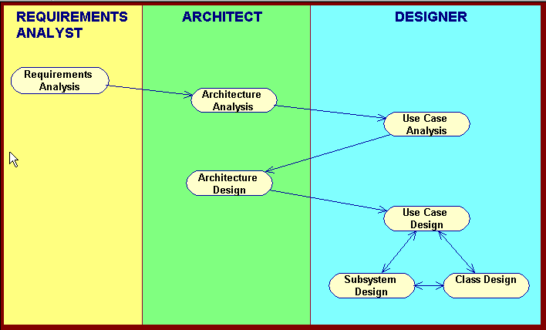
Basic RUP OOAD Activities
Notes:
ID Course Overview

Slide 3
Overview of Requirements Analysis
Use cases are a widely adopted approach to capturing functional system requirements. Use cases are the integrating view in the RUP model of system architecture, and drive the development process throughout the entire lifecycle.
Notes:
ID Course Overview
Functional requirements pertain to what the system does, I.e. behavior
Nonfunctional requirements pertain to other factors such as performance, environment
4+1 model of architecture:
Logical view: end user functionality
Process view: performance, scalability
Implementation view: programmers – software management
Deployment view: system topology, delivery, installation
Use Case view (impacts the other four):

Slide 4
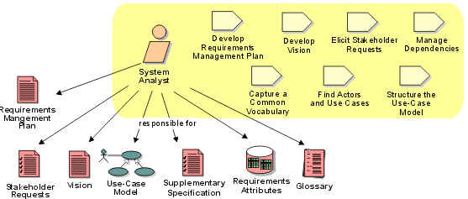
Role: System Analyst
The System Analyst role leads and coordinates requirements elicitation and use-case modeling by outlining the system's functionality and delimiting the system; for example, identifying what actors exist and what use cases they will require when interacting with the system.

Slide 5
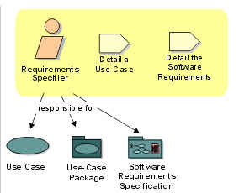
Role: Requirements Specifier
The Requirements Specifier role specifies the details of one or more parts of the system's functionality by describing different aspects of the requirements.

Slide 6
Library System Problem Statement
You have been hired by Prince University to update their library record keeping. Currently the library has an electronic card catalog that contains information such as author, title, publisher, description, and location of all of the books in the library. All the library member information and book check-in and checkout information, however, is still kept on paper. This system was previously workable, because Prince University had only a few hundred students enrolled. Due to the increasing enrollment, the library now needs to automate the check-in/checkout system.
The new system will have a windows-based desktop interface to allow librarians to check-in and checkout books.
All books in the library have a unique bookid.The books in the library are ordered on the shelves by their bookid. The new system must allow library members to search through the electronic card catalog to find the bookid of the desired book.
The system will run on a number of individual desktops throughout the library. Librarians will have their own desktop computers that are not accessible by library members. Only librarians are able to check-in and checkout books.
The system will retain information on all library members. Only university students, faculty and staff can become library members. Students can check-out books for a maximum of 21 days. If a student returns a book later than 21 days, then he/she has to pay an overdue fee of 25 cents per day. University staff can also checkout books for a maximum of 21 days, but pay an overdue fee of 10 cents per day. Faculty can checkout books for a maximum of 100 days, and pay only 5 cents per day for every book returned late. The system will keep track of the amount of money that library members owe the library.
Notes:
ID Course Overview
Actors? Librarian and member
What things do they do, related to our new system?
Librarian – checks out, checks in, manages members
Member – searches books

Slide 7
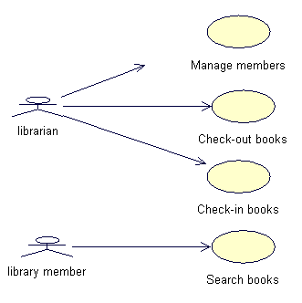
Requirements: Use-case diagram
Notes:
ID Course Overview

Slide 8
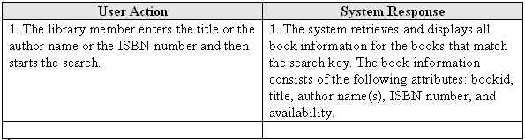
Requirements: Search Books Use Case Description
Search books
This use case allows the library member to search the complete catalogue of books that are available in the library to find book availability and location information. Books can be searched on the following keys: title, author, and ISBN number. The book catalog already exists as a legacy database.
Actors
Library member
Flow of Events
  Basic path
  This use case starts when the Search Books screen is displayed, and the library member requests a book search.
Notes:
ID Course Overview

Slide 9
Basic RUP OOAD Activities

Slide 10
Overview of Arch Analysis
Architectural analysis is a preparation for UC analysis. It provides a comprehensive view of the problem domain and high level system design that will be used across all UC realizations.
Notes:
ID Course Overview
Done once in a project during early Elaboration
2. A configuring of Use case analysis
3. First try at defining pieces/parts of the system and their relationships, and organizing in layers
4. Use Case analysis refines this view

Slide 11
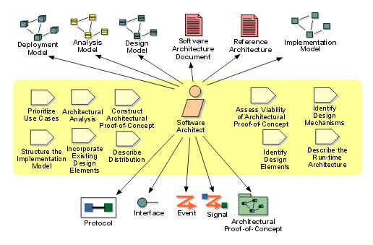
Role: Software Architect
The software architect role is responsible for the software architecture, which includes the key technical decisions that constrain the overall design and implementation for the project.

Slide 12
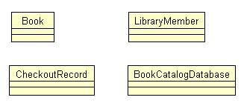
Architectural Analysis: Key abstractions
Key abstractions represent the objects in the problem domain that are of greatest importance in designing a solution. These are the objects that need to interact in order for a software solution to accomplish the aim of the use cases.
Notes:
ID Course Overview
Also begin to specify layers:
presentation
application
business services

Slide 13
Basic RUP OOAD Activities

Slide 14
Overview of Use Case Analysis
Analysis is the process of understanding in detail
the business domain (Systems Analysis)
the user requirements (Use Case Analysis)
The defining feature of use case analysis is focusing analysis activities on individual use cases. Typically, this phase of analysis makes use of several types of UML diagrams:
1. Use sequence diagrams to determine the responsibilities required for participating classes to carry out each use case.
2. Collaboration diagrams (called Communication Diagrams in UML 2.0) reflect required associations among classes.
3. The VOPC (View of Participating Classes) diagram captures the structural relationships among classes. This is a special kind of class diagram
Notes:
ID Course Overview
VOPC = View of Participating Classes – all classes that participate in a use case

Slide 15
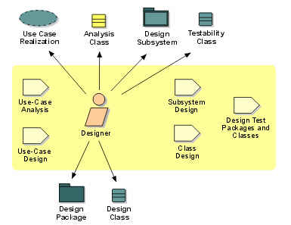
Role: Designer
The designer role is responsible for designing a part of the system, within the constraints of the requirements, architecture, and development process for the project.

Slide 16
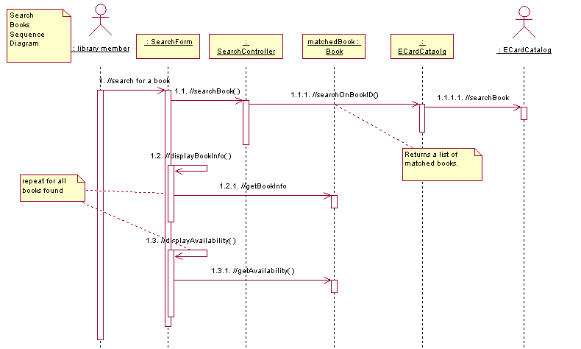
Use-case Analysis: Sequence Diagram

Slide 17
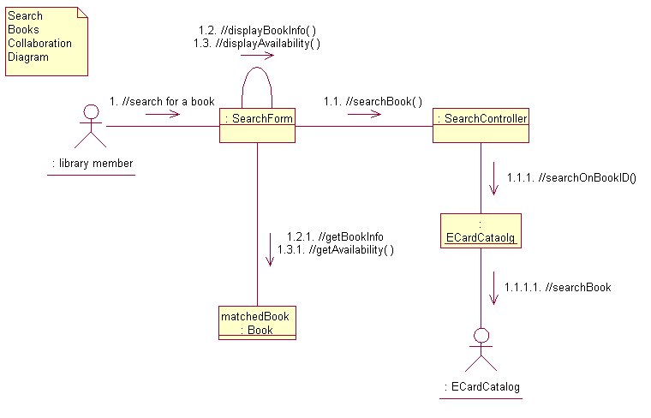
Use-case Analysis: Collaboration Diagram

Slide 18
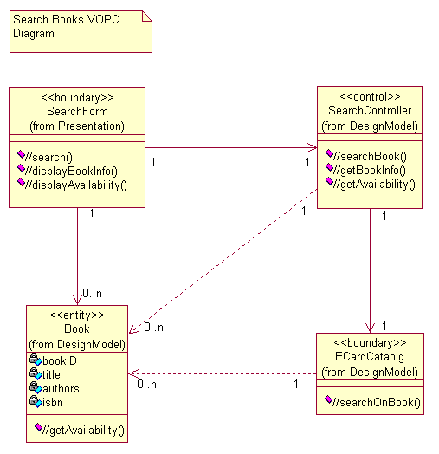
Use Case Analysis: VOPC Diagram

Slide 19
Basic RUP OOAD Activities

Slide 20
Overview of Arch Design
The architect makes system-wide preparations that guide and coordinate the design activities of individual designers.

Slide 21
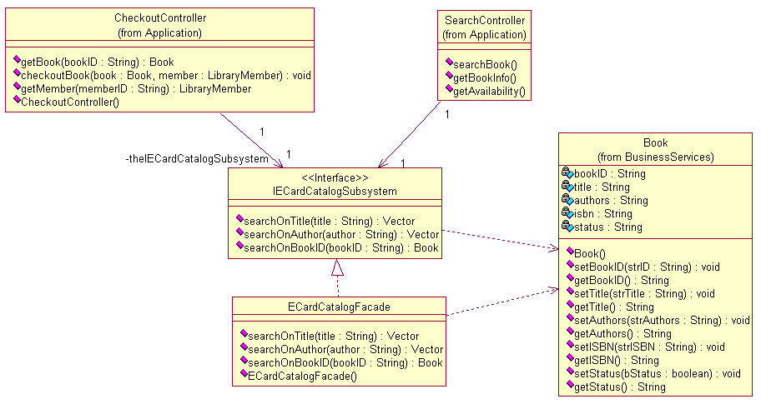
Architectural Design : Subsystem Context Diagram

Slide 22
Basic RUP OOAD Activities

Slide 23
Overview of Use Case Design
Theme: During use case design we inspect and elaborate architectural design results from the perspective of the use cases.

Slide 24
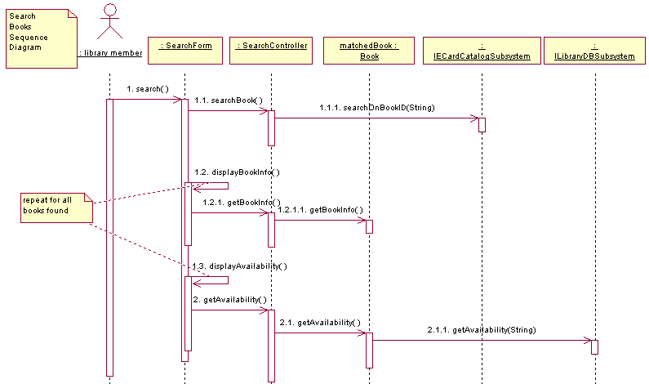
Sequence Diagram Updated with Design Elements

Slide 25
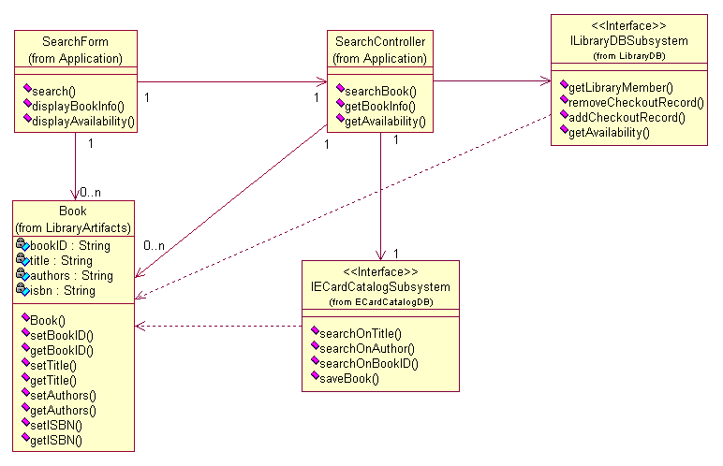
VOPC Diagram Updated with Design Elements

Slide 26
Basic RUP OOAD Activities

Slide 27
Overview of Subsystem Design
Subsystem design involves working out the details of subsystem operations. The steps are basically the same as those of use case analysis and use case design, except now the work is restricted to a single subsystem (at a time) and there is correspondingly more design detail.
As in use case design, main outputs are interaction (dynamic) and class (static) diagrams of the subsystem elements.

Slide 28
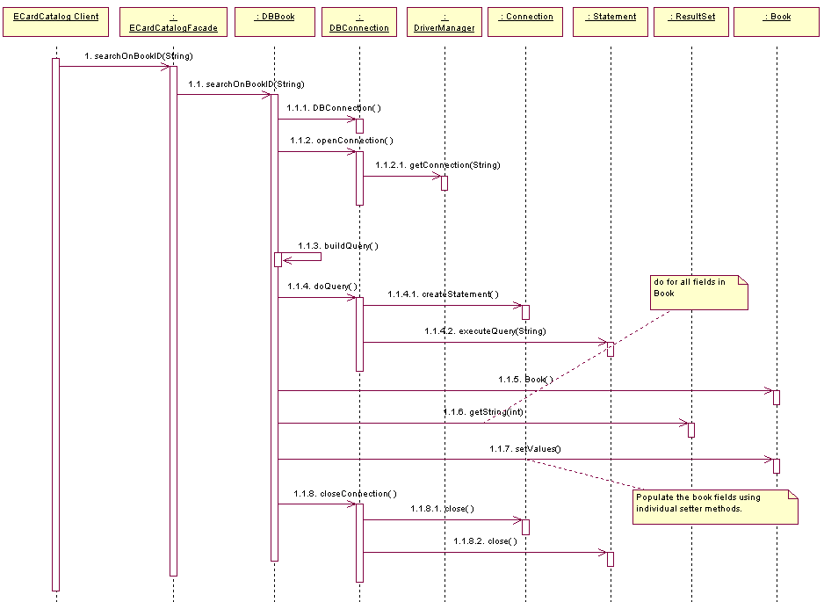
Sequence Diagrams for Each Interface Operation

Slide 29
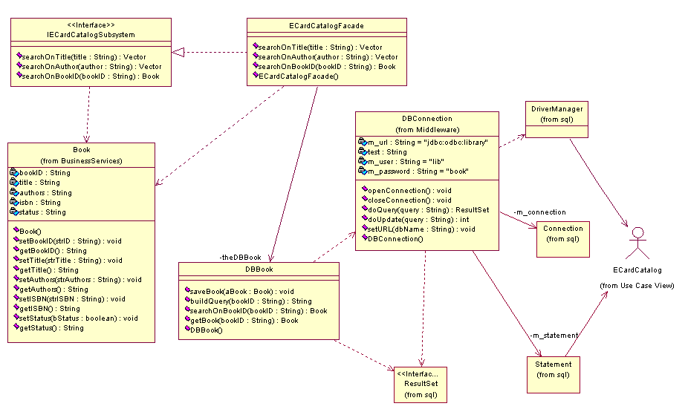
Class Diagram for Subsystem

Slide 30
Basic RUP OOAD Activities

Slide 31
Overview of Class Design
Theme: Class design is a final preparation for implementation. The overall architecture as well as the functional structure is already set. Class design is making final design refinements.

Slide 32
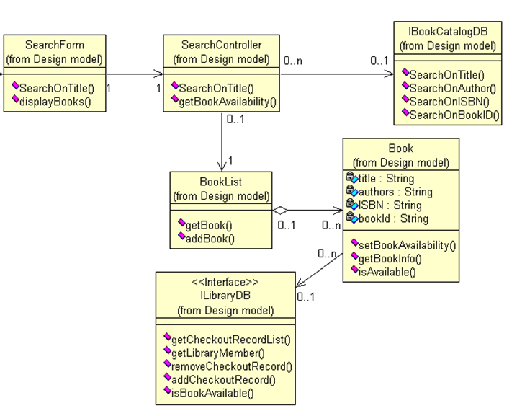
Refined VOPC Class Diagrams

Slide 33
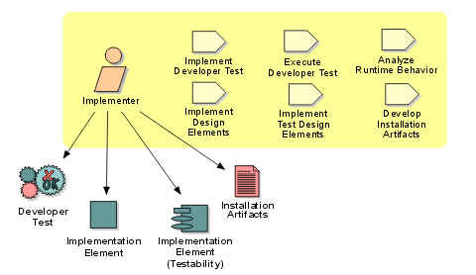
Role: Implementer
The implementer role is responsible for developing and testing components, in accordance with the project's adopted standards, for integration into larger subsystems. When test components, such as drivers or stubs, must be created to support testing, the implementer is also responsible for developing and testing the test components and corresponding subsystems.

Slide 34
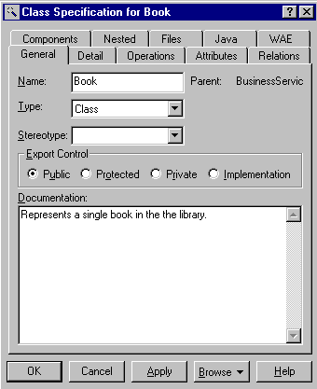
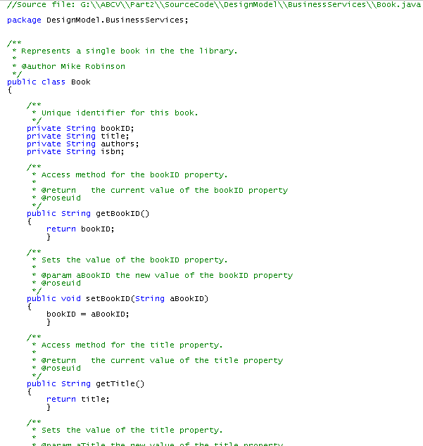
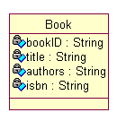
Generated Code for Book
Notes:
ID Course Overview
Removed a few questions that were not so relevant to the SWEng course. Kl 29 Oct 02

Slide 35
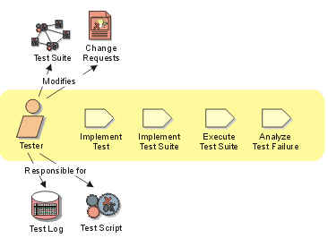
Role: Tester
The Tester role is responsible for the core activities of the test effort, which involves conducting the necessary tests and logging the outcomes of that testing.

Slide 36
The Unified Process Artifacts
Requirements
  Use-case diagram
  Use-case descriptions
Architectural Analysis
  Key abstractions
  Upper level architectural layers
Use-case Analysis
  Sequence diagrams
  Collaboration diagrams
  VOPC diagrams
  Analysis class to analysis mechanism map
Architectural Design
  Subsystem context diagram
  Analysis class to design elements map
  Design elements to “owning” package map
Use-case Design
  Updated interaction diagrams including design elements
  Updated VOPC class diagrams including design elements
Subsystem Design
  Interaction diagram for each interface definition
  Class diagram for subsystem
Class Design
  Refined and updated VOPC class diagrams

Slide 37
Review of Key Points
What are the analysis activities?
What are the design activities?
What activities are the primary responsibility of the architect?
What activities are the primary responsibility of the designer?
What are the 3 diagram artifacts produced during use case analysis?
What is the purpose of use case analysis?
Notes:
ID Course Overview
Analysis: requirements analysis, architectural analysis, uc analysis
2. Design: architectural design (subsystems specified), class design
3. Architectural analysis and design

